Slide 1
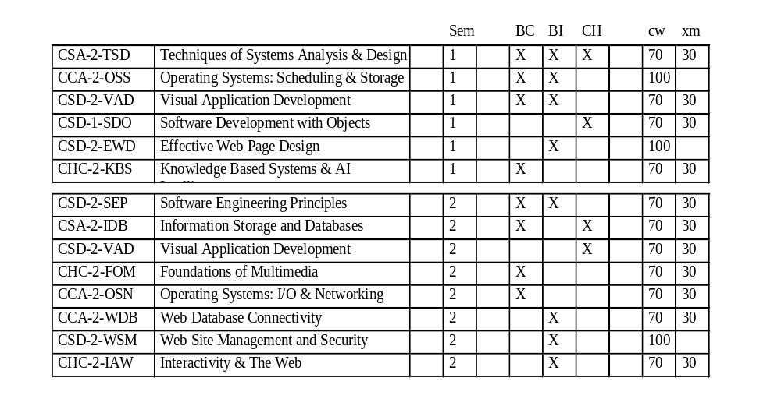
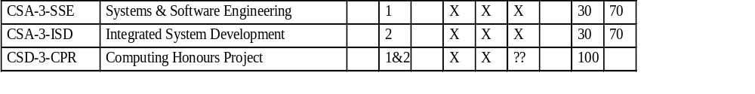

Slide 2
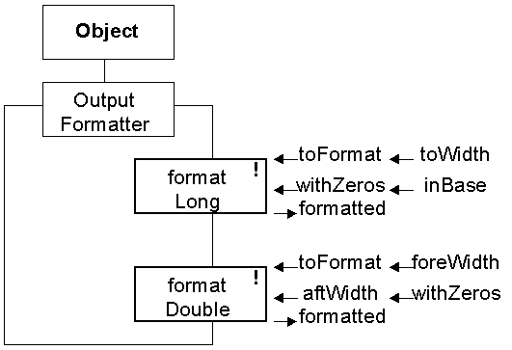
System.out.println( OutputFormatter.formatLong( anyLong,
12, true, OutputFormatter.DECIMAL))
System.out.println( OutputFormatter.formatFloat( demoFloat,
12, 0, false));

Slide 3
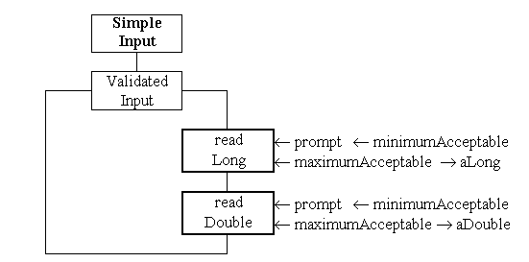
demoLong = ValidatedInput.readLong(
"Please enter your value : ",
200, 300);
demoDouble = ValidatedInput.readDouble(
"Please enter your value : ",
-100.0, +100.0);

Slide 4
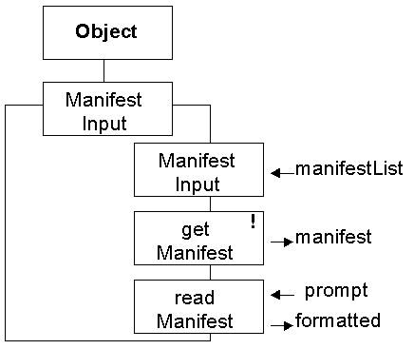
String colours[] = { "red", "orange", "yellow", "green",
"blue", "indigo","violet"};
ManifestInput colourInput = new ManifestInput( colours);
int colourValue = 0;
colourValue = colourInput.readManifest(
"Please enter a colour of the rainbow ");

Slide 5
The user is the most important part of the system.
Speak the user’s language.
It is not possible for the user to make an ‘error’.
Treat the user with respect.
Prevent the user from making ‘errors’.
Trap any ‘errors’ as soon as possible.
Don’t tax the user’s memory - use the screen.
Be consistent.
Less is more!
Help doesn’t!
Close every action.
→ Try it out on yourself ←

Slide 6
type size(bits) default minimum maximum
byte 8 0 -128 +127
short 16 0 -32768 +32767
int 32 0 -2147483648 +2147483647
long 64 0 -9223372036854775808
+9223372036854775807
++ -- + - * / % << >> >>> <<<
& | ^ *= /= %= += -= &= |= ^=
= == != > < >= <=
Other operations in package java.lang.Math
e.g. public static int abs(int anInt)

Slide 7
type size(bits) default minimum maximum
float 32 0.0 1.40129846432481707e-45. 3.40282346638528860e+38.
double 64 0.0 4.94065645841246544e-324 1.79769313486231570e+308
+ - * /
+= -= *= /=
= == != > < >= <=
Other operations in package java.lang.Math
e.g. public static double sqrt(double number)
throws ArithmeticException

Slide 8
byte
short
int
long
float
double
unsafe
explict
safe
implict
anyInt =
(int)anyLong;
anyLong =
anyInt;

